Slide 1


ECEN 403 Demo Slides Team 61 HARD William Jachimiak, Jean Jacques Chirat, Preston Bowyer, Aiden George

Slide 2
Problem Overview
Our project seeks to solve the problem of monitoring fall injury prone individuals in assisted-care through the following implementation:
Collection of vertical position & velocity data (minimally invasive) using mmWave radar
Stream the data to Raspberry Pi to be processed by ML detection algorithm
Raspberry Pi communicates positive detection result over WiFi network to Firebase
Firebase interfaces with Android app to notify assisted-care workers if fall event occurs

Slide 3
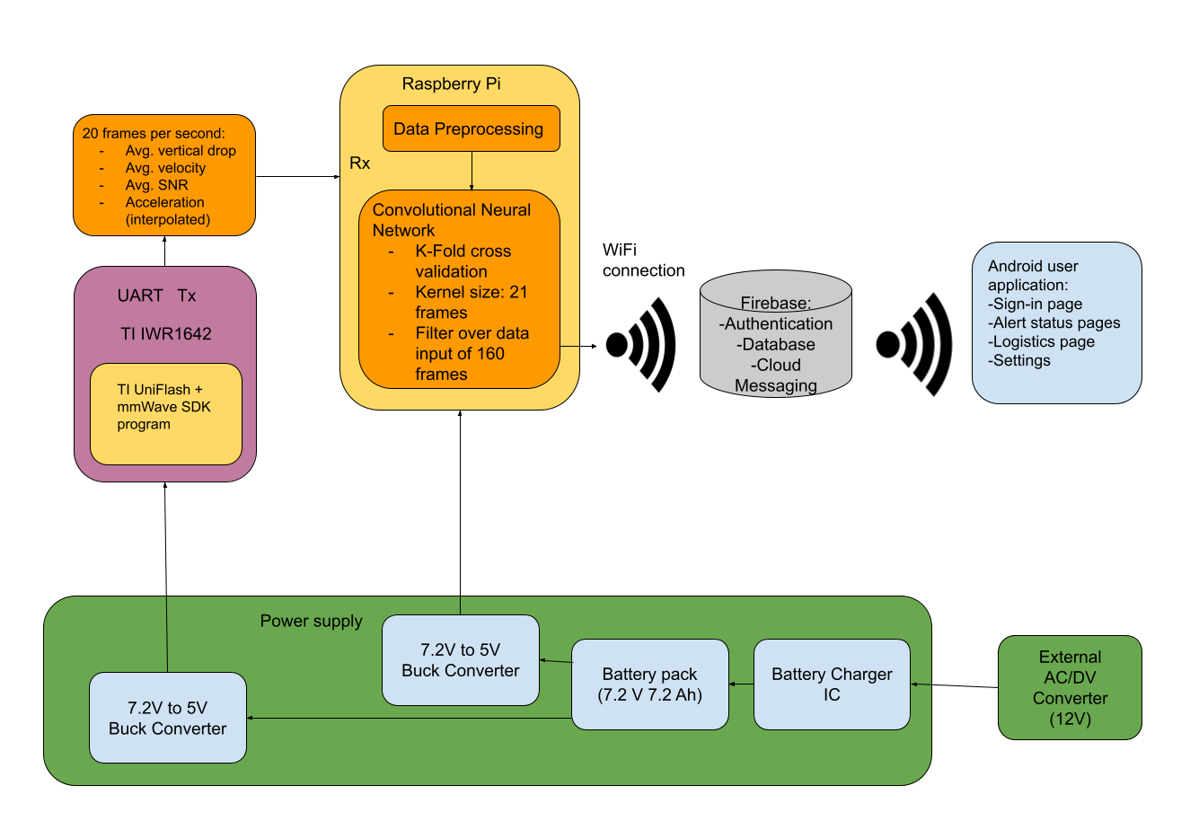
Problem Overview (System Diagram)

Slide 4
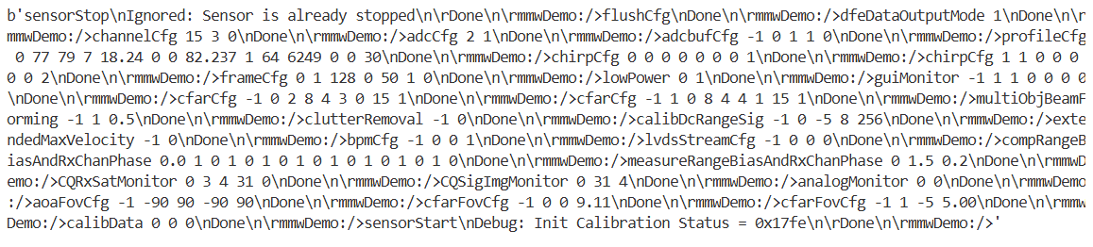
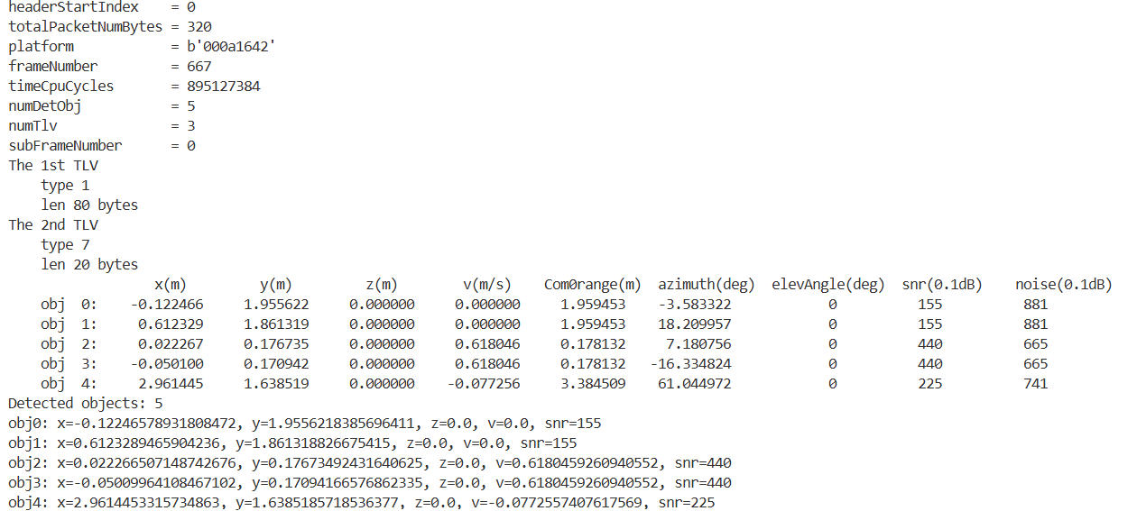
MCU Subsystem

Slide 5
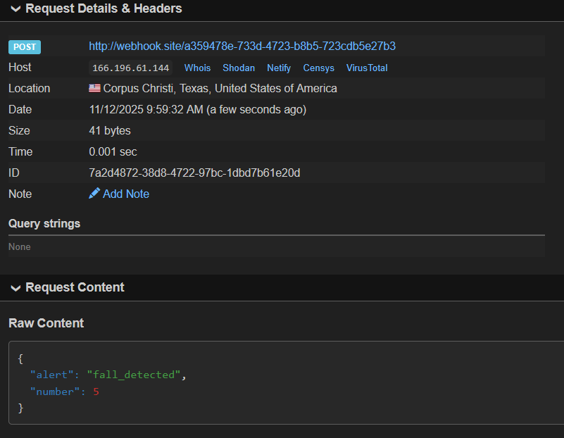
MCU Subsystem

Slide 6
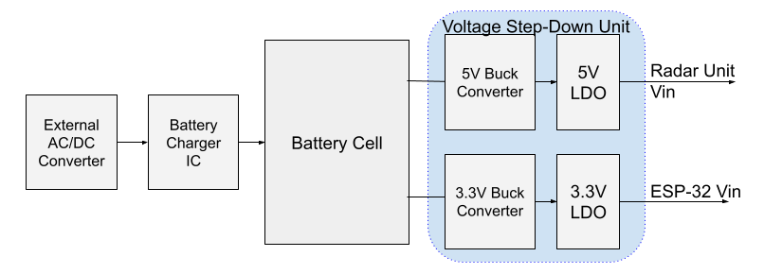
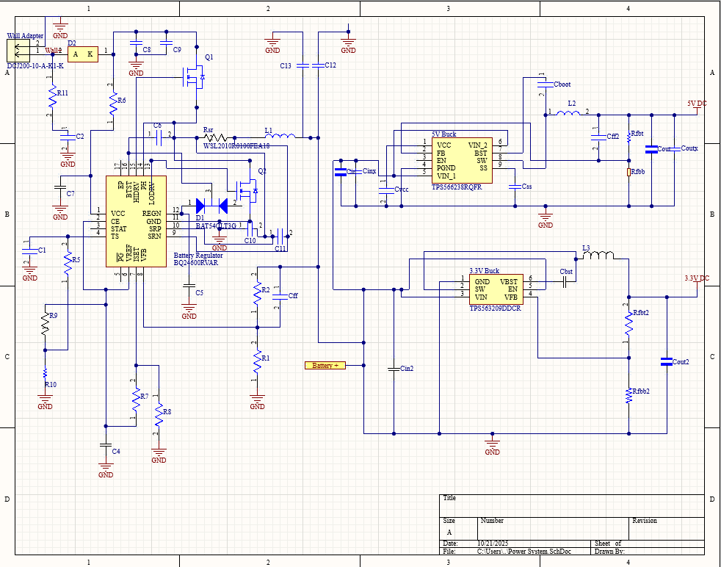
Power System
Provides power both to ESP-32 and Ti Radar Unit using buck converter ICs
Power is stepped down from two Li-Ion 3.6V batteries in series
Battery is charged from a wall mounted 12V AC/DC converted paired with a BQ24600 charging IC to deliver 6A to the battery pack

Slide 7
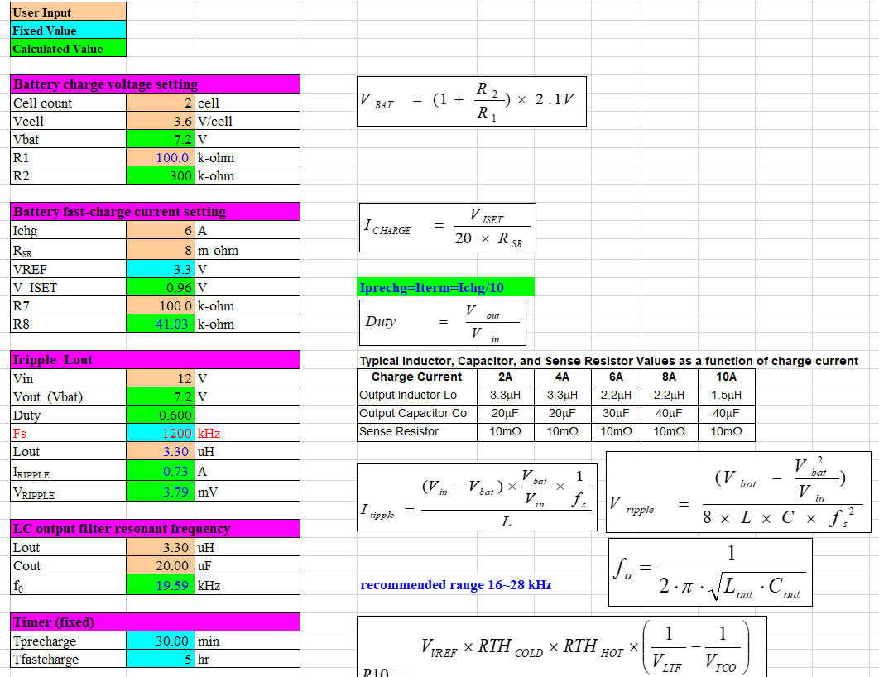
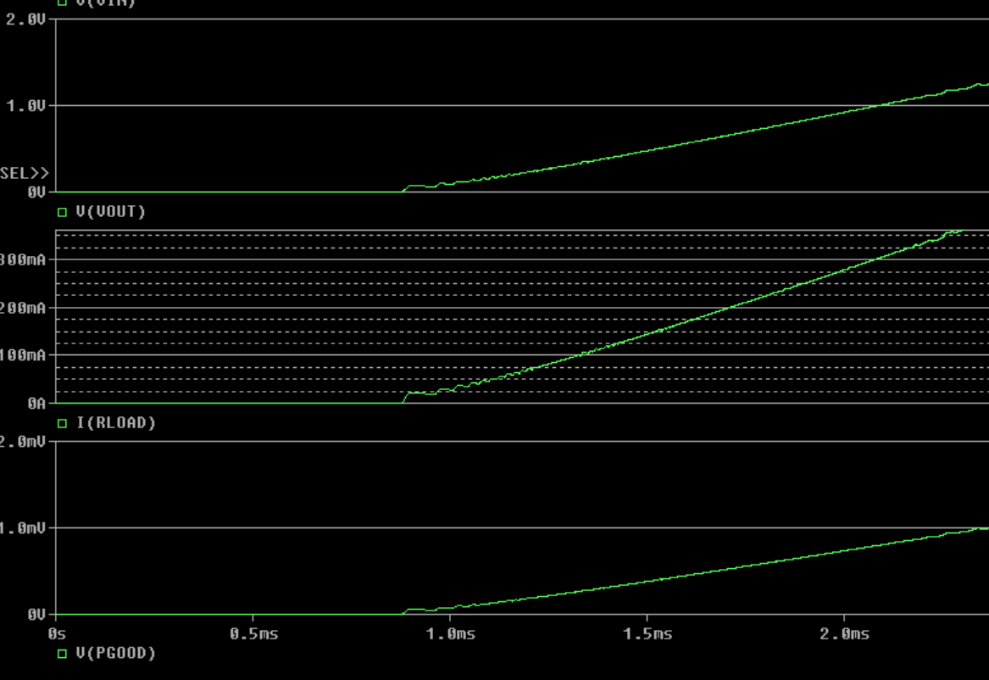
Power Supply
The power system PCB was finalized and ordered, based on design criteria found from Ti Data.
Additional simulation done in PSpice to verify design functionality based on Webench Recommendations
All IC Components have been received, awaiting PCB to begin validation of power system design

Slide 8
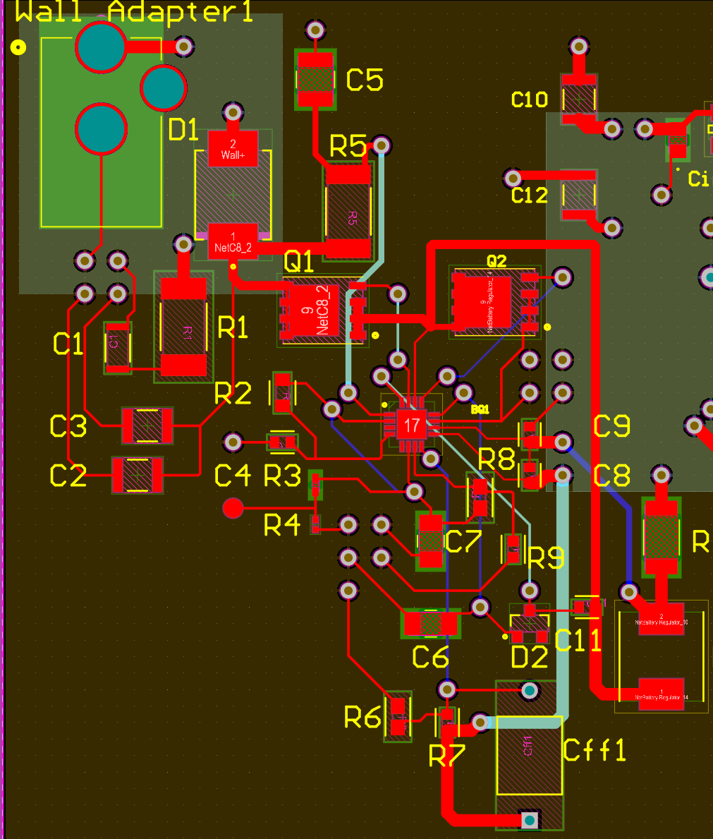
Power Supply PCB

Slide 9
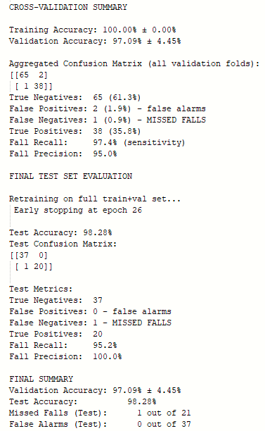
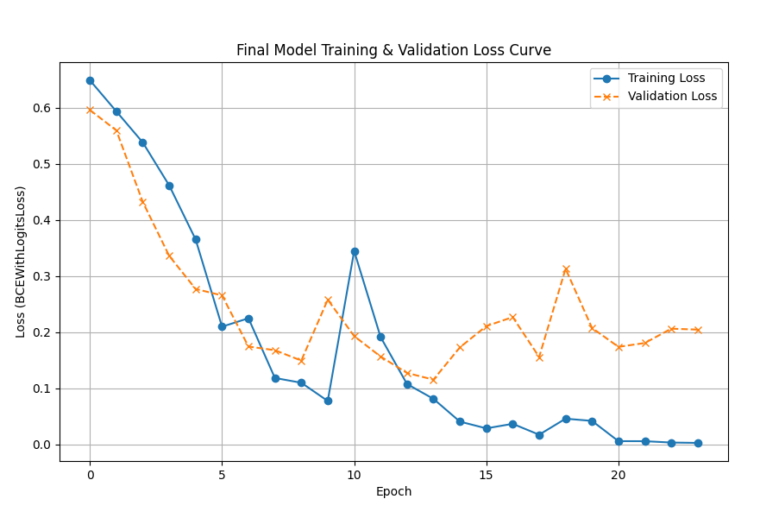
Machine Learning Subsystem
Training + validation loss function over 40- epochs
Terminal output for training result

Slide 10
Machine Learning Validation Plan
Validation Criteria | Definition | Margin | Progress (as of latest model) | Status
False Positive Rate | A non-fall event which is classified as a fall event as a ratio of all non-fall cases | < 5% | 2.99% | Achieved
False Negative Rate | A fall event which is classified as a non-fall event as a ratio of all fall cases | < 5% | 2.56% | Achieved
Train & Test Dataset Size | The combined number of datasets used for model training and datasets for model simulation | > 200 | 164 | In progress
Fall Positive Dataset | Number of datasets which serve as ground truth for falling scenario or '1' | > 80 | 60 | In progress
Fall Negative Dataset | Number of datasets which serve as ground truth for non-falling scenario | > 120 | 104 | In progress
Edge case handling | Model must account for motion patterns that do not conform to majority of fall or non-fall patterns | At least 33% of non-fall data | 20 | In progress
Confuser Rejection | Combined total of false positive and false negative classifications as a ratio of total test cases | < 3% | 2.83% | Achieved
Noise handling | Model must account for noise that may be present in real-life residences | N/A | Added Gaussian noise of magnitude 0.1 | Achieved
Detection delay | Model must be able to completely process any falling motion data within a reliable timeframe | < 10 s | TBD in integration | N/A
Computation Speed | Real-time data must be converted to .json, preprocessed, and classified before the processing of the following data batch. A standard data batch will be 160 frames, so a dataset of this length will be used to set the benchmark. | < 8 s | 0.313 s | Achieved

Slide 11
End User App
Core Features
User Authentication: Secure login via Firebase Auth
Real-Time Alerts: Firestore live stream; room, time, and details shown immediately
Acknowledge Workflow: Updates Firestore with acknowledgedBy + timestamp
Push Notifications: FCM alerts routed to the phone; tapping opens correct alert
Logistics Dashboard: Room-based activity overview with bar chart analytics
Clean UI: Unacknowledged / Acknowledged / Logistics / Settings tabs with alert badges
Cloud Integration: All data stored, queried, and updated through Firestore
ESP32 Simulation: Python script generates alerts + FCM notifications for demo/testing

Slide 12
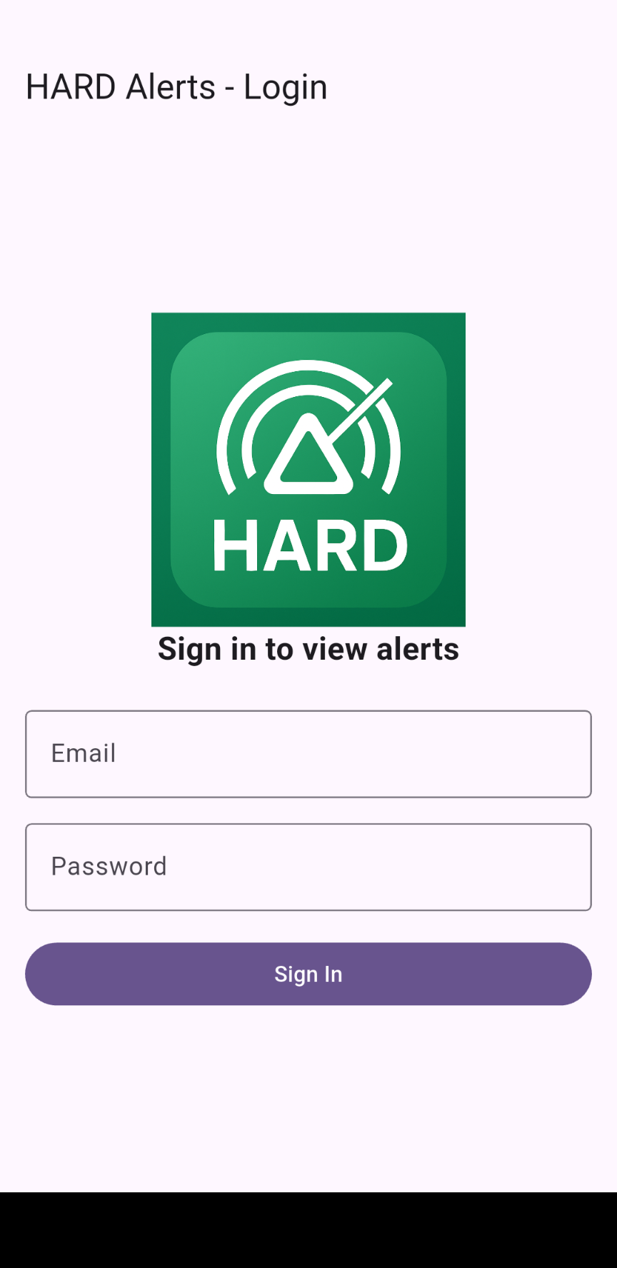
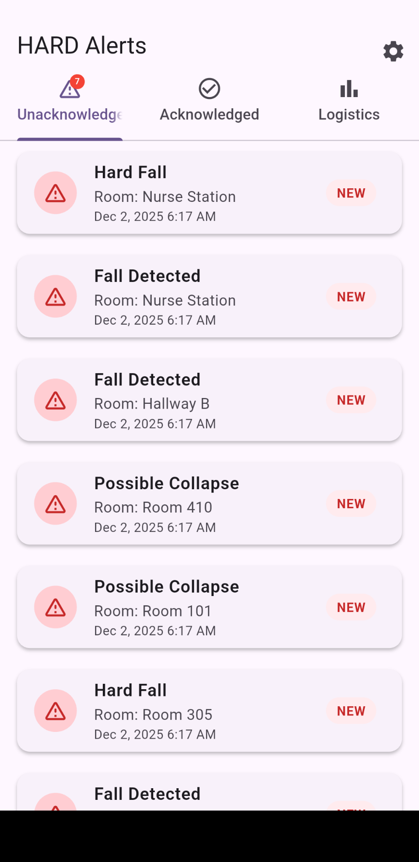
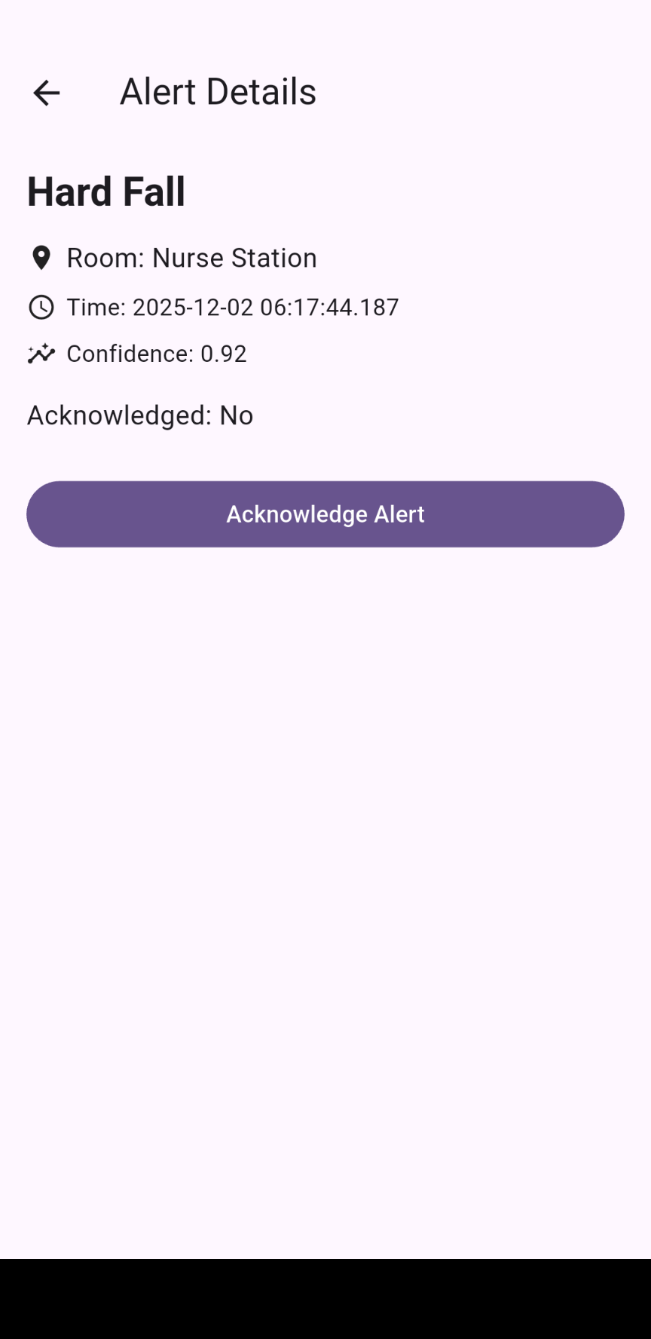
End User App

Slide 13
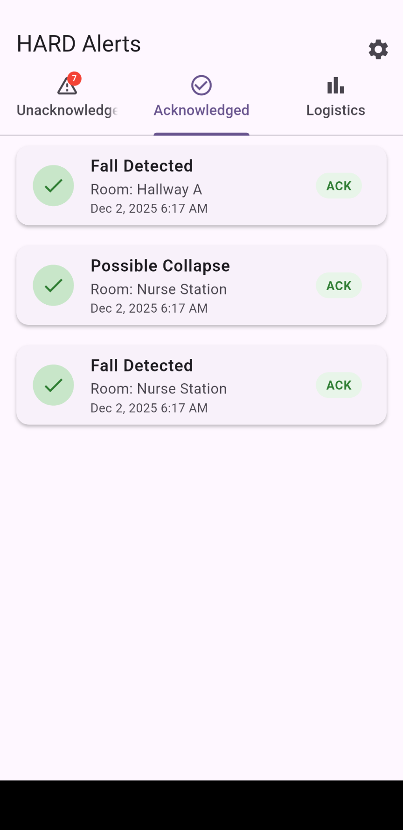
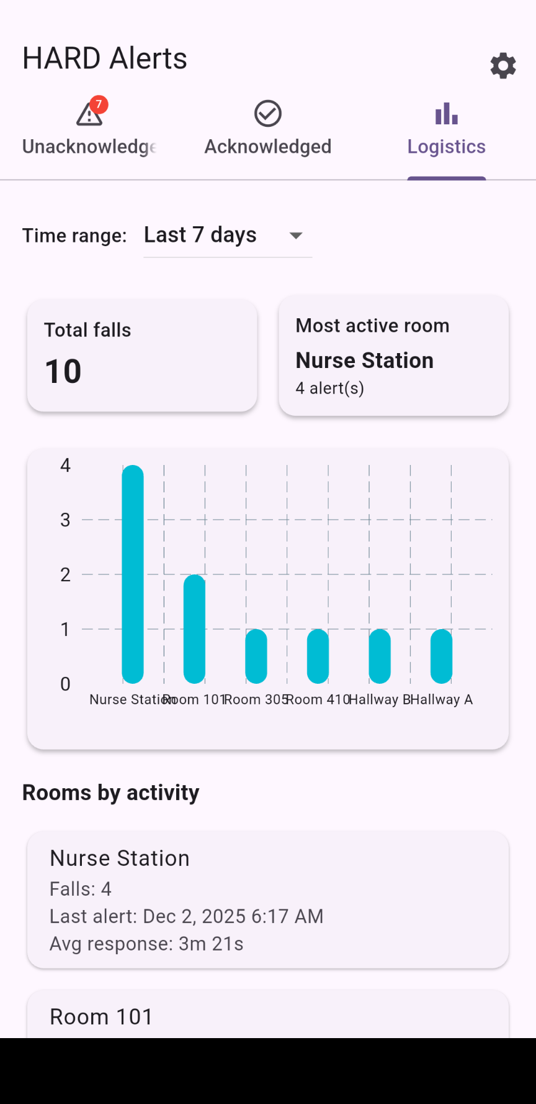
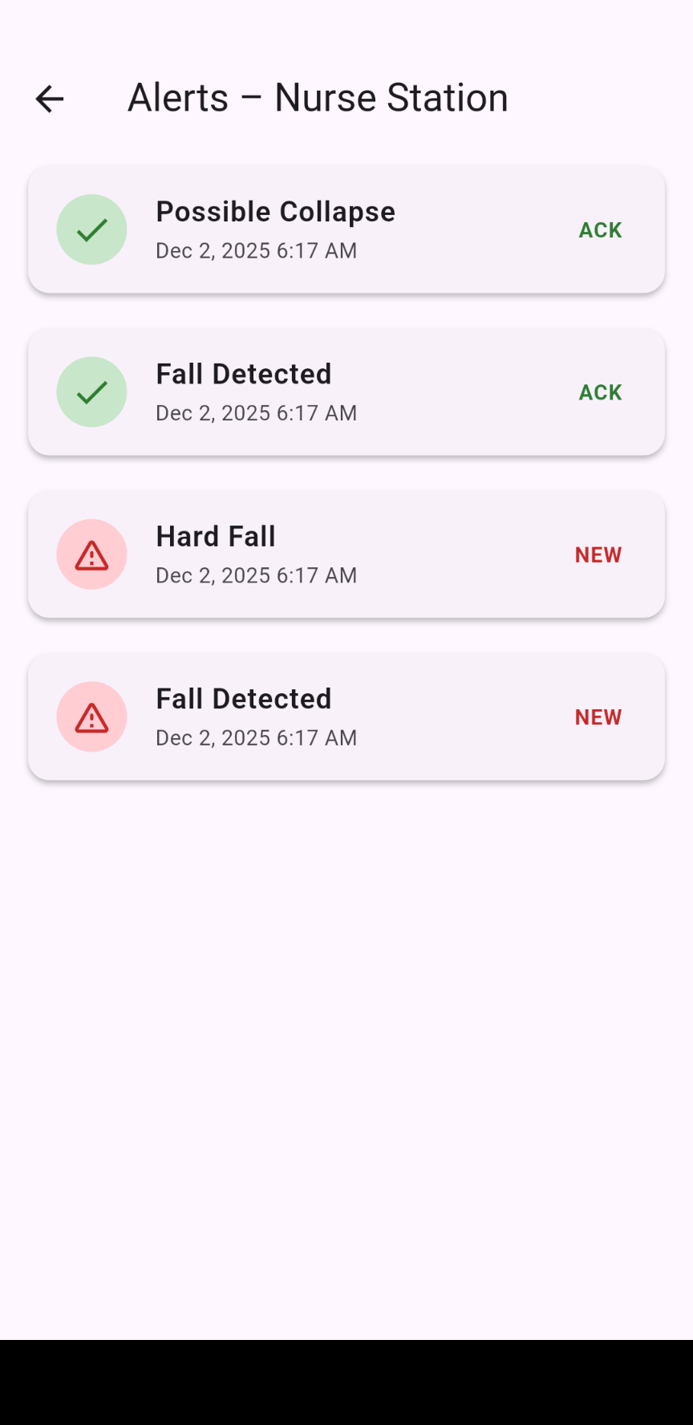
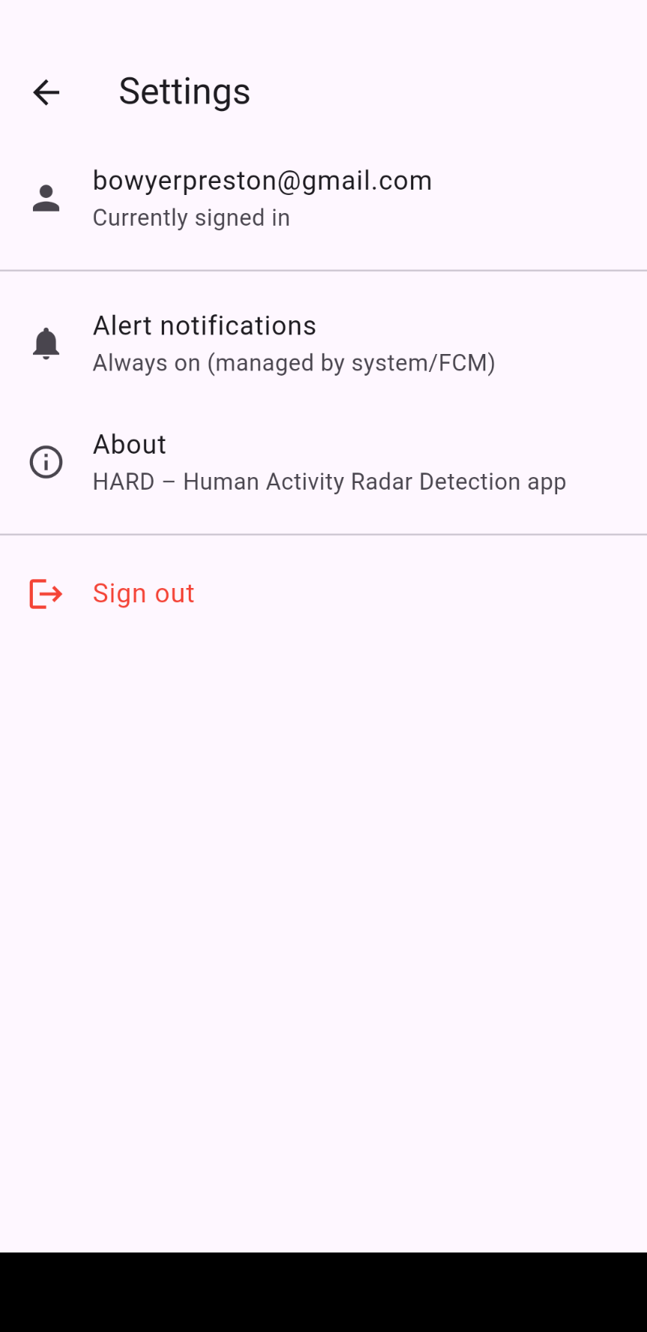
End User App

Slide 14
Validation Plan
Task | Specification | Owner
Peak Power | 10 W | Aiden
Maximum Charger Current | 6A | Aiden
Maximum Battery Life | 10 hr | Aiden
Radar Detect Distance | 8m | All
Detection False Positive Rate | ≤ 5% | JJ/William
Detection False Negative Rate | ≤ 5% | JJ/William
Push Notification delivery success | ≥ 99% | Preston
Notification time | ~ 5 seconds | Preston

